Slide 1
Make Your Own Visual Collages

Slide 2
Part of a visual collage from the Chicago Community Climate Action Toolkit, courtesy of The Field Museum. The Connect collages tool expands the Visual Collages tool first created by The Field Museum. Special thanks to the museum for allowing us to use it as a model.
Why Visual Collages?
Visual collages get people talking about climate action. You can use them to start conversations with people about what they are already doing related to climate action; what their families/communities have done in the past; and what they want to do—or don’t want to do—moving forward.
Objective: Help community members see that they’re already engaged in activities that are good for the climate. Find out where there is already community activity and interest in climate
Audience: Middle school and up
Materials: For collages: digital or hard copy photos/images of your community, computer with PowerPoint and printer or sturdy paper, scissors, and glue. For interviews: collages, paper, and pen
Time Needed: 2 hours-2 days to make collages (depending how much prep you want to do), 10-30 minutes for one interview

Slide 3
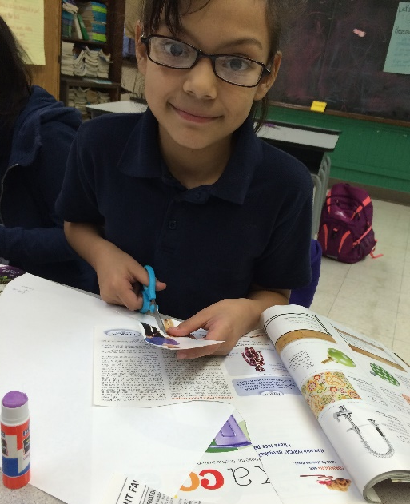
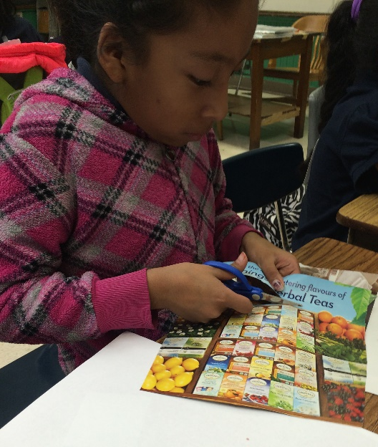
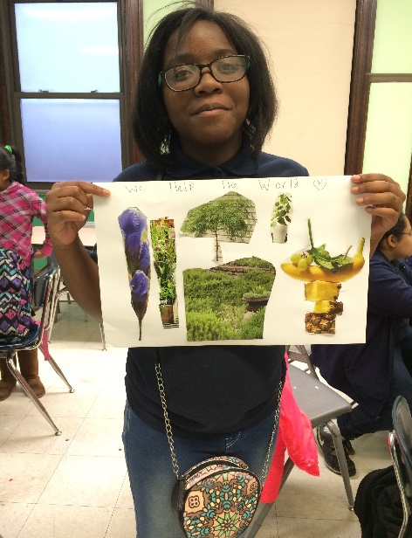
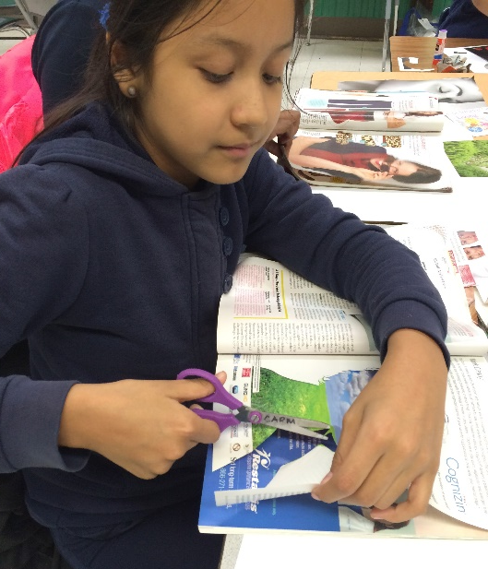
Why Create Your Own?
Your work will be most successful if you create your own collages, tailored to your region, communities, climate impacts, and local/regional climate plans. Place-based work is helpful in identifying local assets to build on and interesting people in climate-related work. Visual collages are largely about helping people see themselves, and people and places like them, in the climate picture.
Consider creating collages on topics that correspond to local climate action plans or community-based projects.
Instructions for making your own are included further down in this document.
Students from Frederick Funston Elementary School in the Logan Square neighborhood of Chicago made visual collages about their impact and influence on the climate change problem as part of an after school program with Connect partner Project Exploration.
Photo courtesy of Project Exploration.

Slide 4
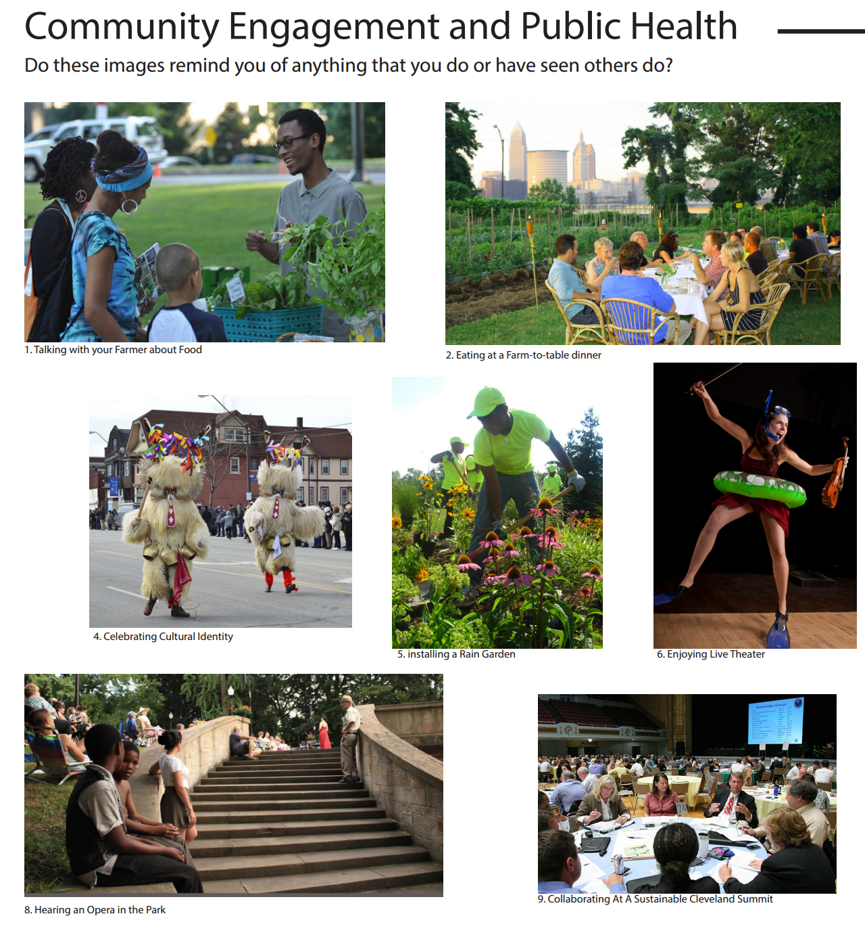
Existing Collages
For more inspiration—or if you just prefer to use existing collages or want to supplement some you make with others on different topics—take a look at these collages:
Connect food and garden collages highlighting the Great Lakes region, at the end of this tool
The Field Museum’s Chicago Community Climate Action Toolkit collages on energy efficiency, renewable energy, waste reduction, transportation, land, and water (http://climatechicago.fieldmuseum.org/)
The Cleveland Neighborhood Climate Action Toolkit collages on land, energy, transportation, waste, and community engagement and public health (http://tinyurl.com/clevelandtoolkit)
Visual collage courtesy of the Cleveland Neighborhood Climate Action Toolkit.

Slide 5
How to Use Visual Collages
Use the collages to have conversations with community members about what they are already doing that is climate-friendly, what more they want to do, and what barriers they encounter.
Conversations can be short (10 minutes) or long (30 minutes per collage or talk about multiple collages for longer) and can be done anywhere—on a street, in a workshop, or in a classroom, for example.
Start by asking the questions on the front of the collage: “Do these images remind you of anything that you do or have seen others do?” Then ask for more details based on the response, encouraging the interviewee to tell you stories about their life.
If you want to ask more structured questions, try the ones on the back of the collage.
Bring a notebook and pen with you and make sure to jot down notes for later. Once you’ve done a bunch of interviews, you and your fellow interviewers should look through your notes to identify what kinds of things people seem to be engaged and interested in overall.
Note that there is no interview guide per se. Think of this as a conversation more than an interview. You are trying to draw out stories. The goal is to help community members see that activities they’re engaged in are, in fact, good for the climate.
The other goal is to help the interviewer start to understand where there is already community activity and interest in climate action.

Slide 6
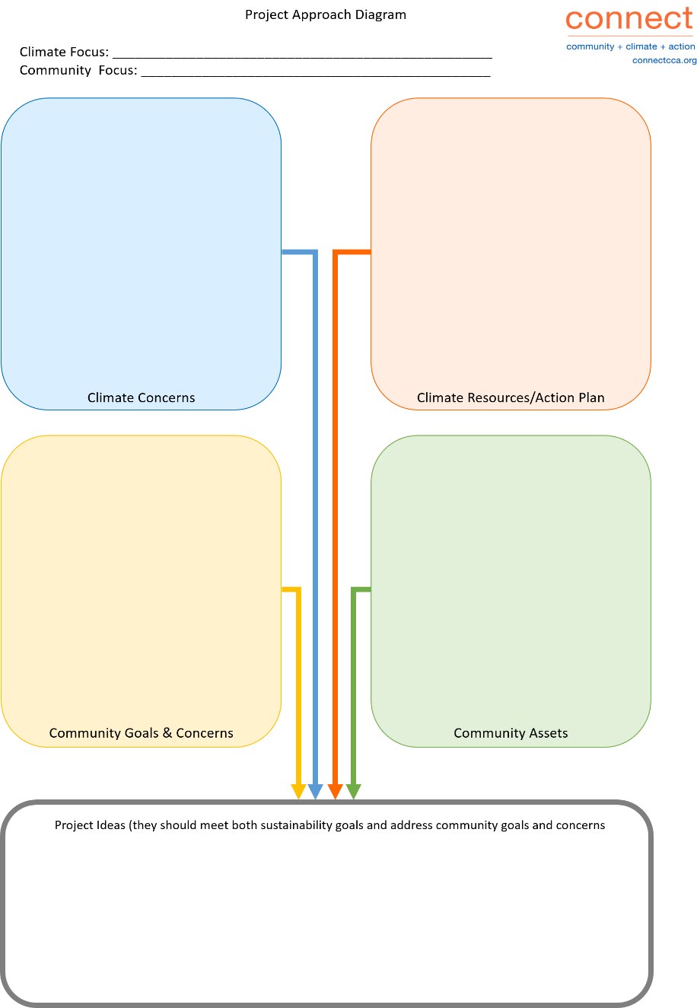
What’s Next?
As you use these collages to have conversations with community members, you will learn what people are already doing related to climate action and what they care about and would like to try. You can use this knowledge to develop project ideas tailored to your community that people will likely want to get involved in.

Slide 7
Instructions for Making Your Own Collage
Just drop your own photos and text into the templates on the next two slides. Put photos on the first slide, with very short captions. On the second slide, write a more detailed description of each photo in the Captions section. In the Questions section, suggest some questions to start conversations. Check out sample collages at the end of this document.
A few tips:
Choose one theme for each collage (such as food, gardening, health, education, or another theme from your local climate plan or of interest in your community).
Type in your own title, caption and questions, replacing the text enclosed by brackets in the template.
Use photos from your region or community that people will recognize.
Include people in as many photos as possible to help people relate.
Resize the photos by dragging the corners.
Use more or fewer photos than the template, if you want; about a dozen photos usually works well.
Number the photos in the caption and use the same numbers for the corresponding descriptions on the second slide.
Make sure to include images credits if the photos come from external sources.

Slide 8
Use a Photo Collage App on Your Phone
If you are app-savvy, you may want to consider making your collages on your phone using a photo collage app such as Phonto or Typic. These are apps that allow you to create collages easily, especially if you are going to use photos on your phone. They provide photo collage layouts and allow collages to be easily shared on social media.
Some apps are clearly geared towards teens and pre-teens, letting you put stars, hearts, etc. on the photos, while others create more professional, sleek collages and even offer templates.

Slide 9
{type in a title based on a theme}
Do these images remind you of anything that you do or have seen others do?

Slide 10
{type title from page one}
Captions
Questions
{type in brief descriptions of each photo shown on page one; be sure to include the number and caption from each photo}
{type in questions that can inspire people to talk about things they do now or in the past}
{type in questions that inspire people to talk about what they can do in the future}
{type your organization’s name here} created this visual collage in partnership with the Connecting Climate to Communities Initiative, based on a design from The Field Museum.

Slide 11
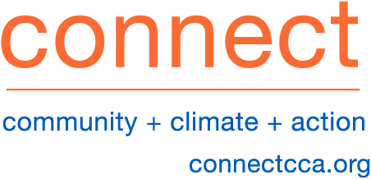
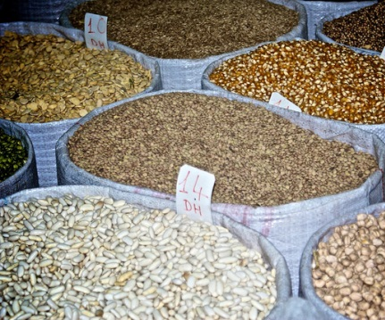
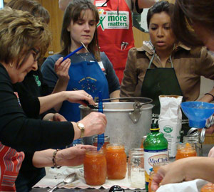
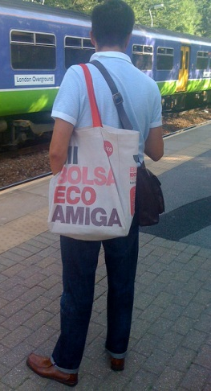
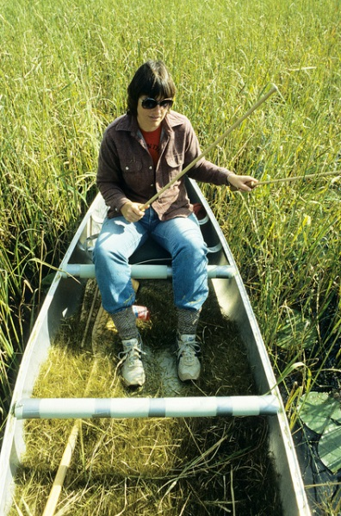
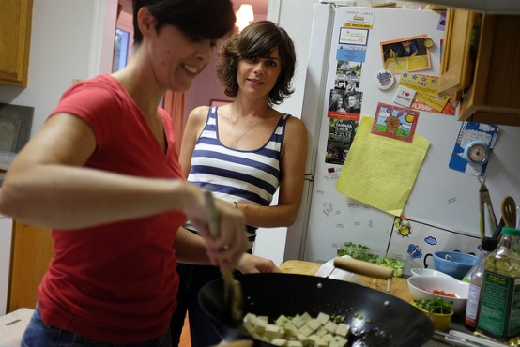
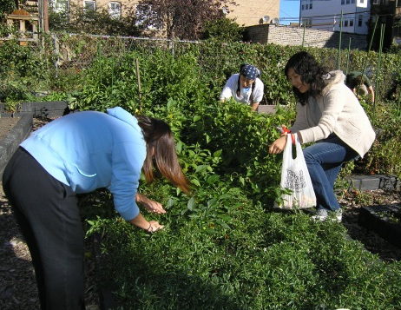
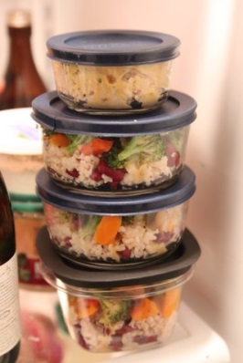
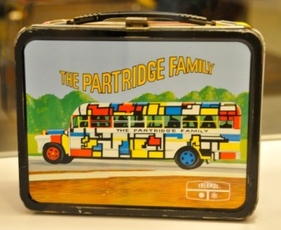
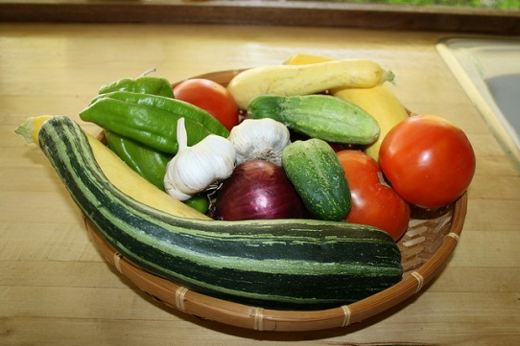
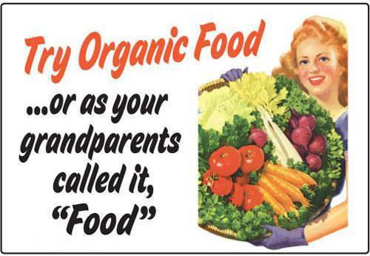
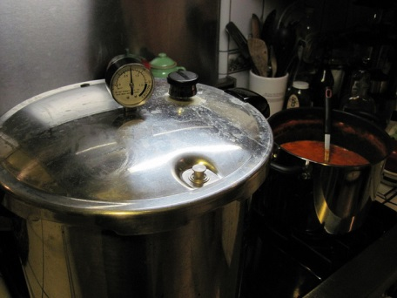
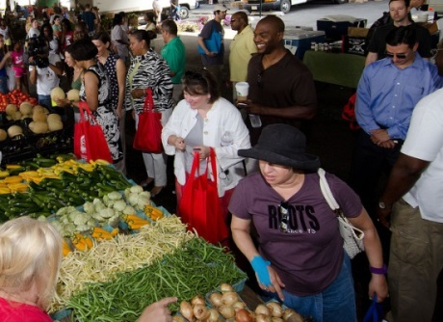
Food
Do these images remind you of anything that you do or have seen others do?
Eating plant-based foods
Buying food in bulk
Canning food
Reusing bags
Maintaining sustainable traditions
Cooking and baking at home
Growing vegetables
Saving leftovers
Packing lunch
Preserving heirloom crops
Eating fresh, local foods in season
Choosing organically grown food
Using a pressure cooker
Shopping at farmers’ markets
Sharing the harvest
Creating a heritage garden

Slide 12
Food
More information (to aid discussion)
Plant-based foods. Meat and dairy production has a big impact on the climate. If a family of four skips meat and cheese one day a week, it has the same impact as parking the car for five weeks and taking three minutes off each person’s daily shower. photo: Field Museum | Buying food in bulk. Packaging adds expense and environmental impact to our shopping carts. Some stores offer staples— like oats, rice, flour, beans, and dried fruit—in bulk bins so you can get just the right amount without a lot of packaging. photo: paul wittal | Canning food. Tomatoes, pickles, jams, sauces, and more can be preserved at home. Canning was nearly a lost art, but people are relearning this skill and saving money, preserving food they have grown and reconnecting with family traditions. photo: Iowa State University Extension | Reusing bags. Don’t worry about choosing paper or plastic, bring your own reusable bag to the grocery store or market. Reusable bags don’t use up resources or create pollution for a disposable product. photo: gingerbeardman | Maintaining sustainable traditions. Before modern luxuries, people primarily ate local foods. Many Native Americans in the Great Lakes region harvested wild rice, taking what they needed while leaving enough to support wildlife and ensure future wild rice growth. photo: Wisconsin Dept. of Natural Resources
Cooking and baking at home. Home-cooked meals are tastier and less expensive than prepared “convenience” foods. Plus, cooking with family and friends provides an opportunity to share food traditions while managing the nutrition and climate impacts of your meals. photo: romanlily | Growing vegetables. Lettuce, greens, tomatoes, cucumbers, herbs, and more can be grown in your own yard or even on a patio. In the Midwest we can easily grow food from spring the late fall; with a little extra effort, we can grow food year-round. photo: Ginkgo Organic Gardens | Saving leftovers. Quick meals are easy to make (and cheap) when you keep leftovers close at hand. Keep your leftovers in reusable containers to cut down on food waste; in the U.S. we waste 40 percent of our food, so cutting down on waste conserves resources and helps solve a big problem. photo: dr.coop | Packing lunch. When you pack your own lunch, you save money. Reusable containers (like a lunch box, take-out boxes or Tupperware) make it easy to carry your lunch without leaks or squashing. photo: Smithsonian Museum | Preserving heirloom crops. Creative farmers have always selected plants with the best flavor and performance, giving us apples, potatoes, and other foods with distinct flavors, textures, and fun names. Choosing heirloom varieties preserves cultural and genetic diversity, which can help in a changing climate. photo: Ginkgo Organic Gardens
Eating fresh, local foods in season. Enjoy fresh food at the peak of flavor while reducing the climate cost. Local food travels fewer miles, which means there’s less pollution from transportation. Locally grown food is available at many stores and farmers markets—and maybe even in your own yard! photo: alasam | Choosing organically grown food. Many of our grand-parents and parents grew up growing vegetables without synthetic fertilizers and pesticides. Growing food organically uses 30-50% less fossil fuel energy than industrial farming methods. |  | Using a pressure cooker. Cooking food in a pressure cooker is much faster than cooking with a typical pot—and that means less energy is used. Pinto beans can cook in 25 minutes; brown rice cooks in 15 minutes. Modern pressure cookers are more convenient than older varieties. photo: djfrantic | Supporting farmers’ markets. Local farmers often sell their produce at markets in parking lots, parks, and churches. Some run in the winter, and many include baked goods and kids’ activities to enhance the fun outing. photo: USDA
More questions
Right now
What are some of your favorite foods that you think are sustainable & healthy?
Who is your favorite cook?
What is your favorite vegetable?
In the future
Is there anything you think or dream about doing that you see in the pictures but have not done yet?
Why do you think the idea of doing that appeals to you?
What have been the barriers to getting started?
Special thanks to The Field Museum for the collage template.

Slide 13
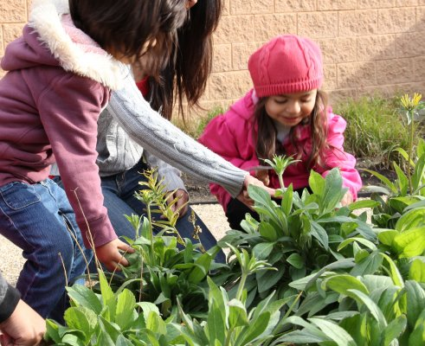
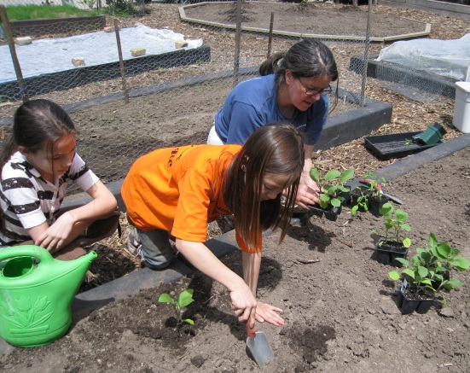
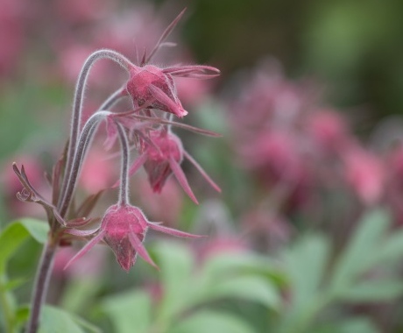
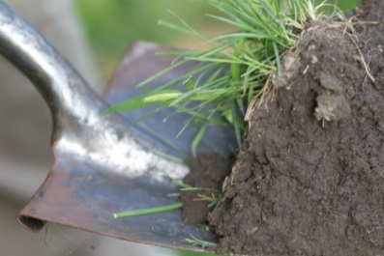
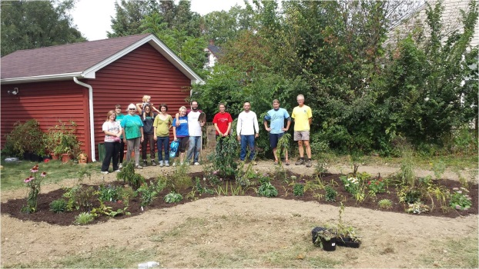
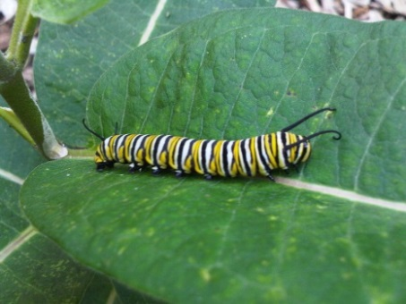
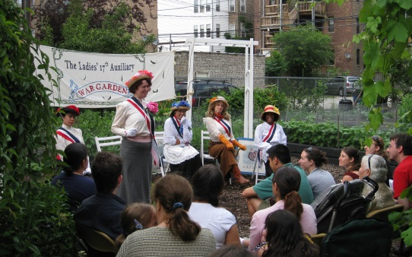
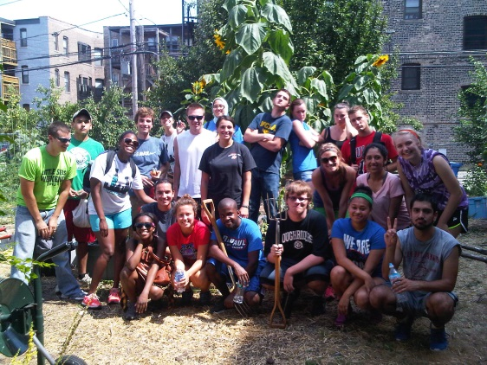
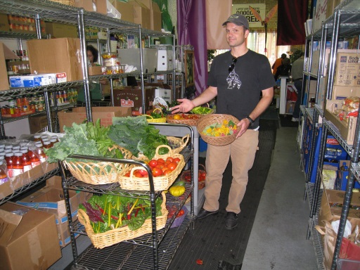
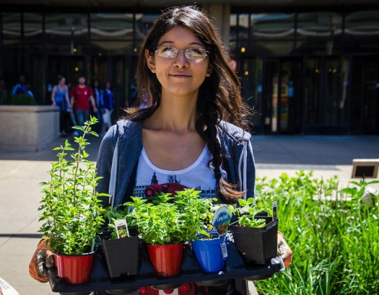
Gardens
Do these images remind you of anything that you do or have seen others do?
Composting
Gardening and learning together
Growing vegetables
Growing native plants
Soil testing
Keeping a rain garden
Maintaining butterfly habitat
Partying and performing in the garden
Using rain barrels
Sharing the harvest
Seed-saving
Creating a heritage garden
Volunteering in a community garden

Slide 14
Gardens
More information (to aid discussion)
More questions
Right now
What are some of the plants that grow in your yard?
Where is your favorite place to be in a nearby park or your yard?
In the future
Is there anything you think or dream about doing that you see in the pictures but have not done yet?
Why do you think the idea of doing that appeals to you?
What have been the barriers to getting started?
Composting reduces waste from kitchens and gardens. And using compost in the garden helps soil hold on to water and nutrients, reducing the need for irrigation and fertilizer. It helps gardens and gardeners cope with changes in rainfall patterns. photo: Ginkgo Organic Gardens | Growing and learning together helps share knowledge, observations, and inspiration between generations and cultures. photo: Field Museum | Growing food is an inexpensive way to have healthy, local food while learning about the natural world. photo: Ginkgo Organic Gardens | Growing native plants that are well-adapted to the site can help reduce the need for water and fertilizer—and it provides food and shelter for wildlife, while resisting many pests. photo: Susan Ask
Soil testing gives gardeners information to grow plants more efficiently—saving money, water, and other resources. photo: Joe Mazza / brave lux | Keeping a rain garden creates a beautiful garden that can hold water after big rainstorms, so rain gardens can help reduce flooding. photo: Detroit Shoreway Community Development Organization | Maintaining butterfly habitat gives these important pollinators a place to eat, rest and reproduce. As the climate—and its habitats—change, it’s important to create and maintain habitat. photo: Susan Ask | Partying and performing in the garden takes advantage of the shade and open space in the garden and welcomes people into the garden. photo: Ginkgo Organic Gardens
Using rain barrels lets gardeners store rainwater and avoid turning the hose on at the tap. This conserves water, which is especially important in drought. photo: Susan Ask | Sharing the harvest nourishes the community and keeps food from going to waste. Find a local food pantry that accepts donations. photo: Ginkgo Organic Gardens | Saving seeds preserves cultural and genetic diversity, and gives gardeners a free supply of seeds for future years. photo: Ginkgo Organic Gardens | Creating a heritage garden preserves cultural traditions, while giving people an opportunity to learn sustainable practices from older generations. photo: University of Illinois Chicago Heritage Garden
Volunteering in a community garden is a great way to learn how to garden—and to share your knowledge with others. For anyone without a yard, a community garden can give access to a little piece of land to cultivate.
photo: Ginkgo Organic Gardens
Special thanks to The Field Museum for the collage template.

